Slide 1

The National University of Computer and Emerging Sciences
Decision Trees
Machine Learning for Data Science
Dr. Akhtar Jamil
Department of Computer Science

Slide 2
Goals
Review of Previous Lecture
Today’s Lecture
Decision Trees

Slide 3
Motivation
Problem: Given the following information of a customer, decide whether the bank should assign a loan or not
Classes: Safe or Risky
Features: Credit History, Income, Term, Personal Info
Credit | Term | Income | y
excellent | 3 yrs | high | safe
fair | 5 yrs | low | risky
fair | 3 yrs | high | safe
poor | 5 yrs | high | risky
excellent | 3 yrs | low | risky
fair | 5 yrs | low | safe
poor | 3 yrs | high | risky
poor | 5 yrs | low | safe
fair | 3 yrs | high | safe

Slide 4
Motivation
x_{i} = (Credit History = poor, Income = high, Term = 5 years)
Start
excellent
poor
Credit?
fair
Safe
Term?
Income?
high
Low
3 years
5 years
Risky
Safe
Term?
Risky
3 years
5 years
Risky
Safe

Slide 5
Decision Trees
Decision tree (DT) is a machine learning algorithm.
Its learning function is represented by a decision tree.
DT can also be represented as sets of if-then rules.
Among the most popular of inductive inference algorithms
Applied to a broad range of tasks:
Medical diagnosis
Credit risk analysis
Object classification

Slide 6
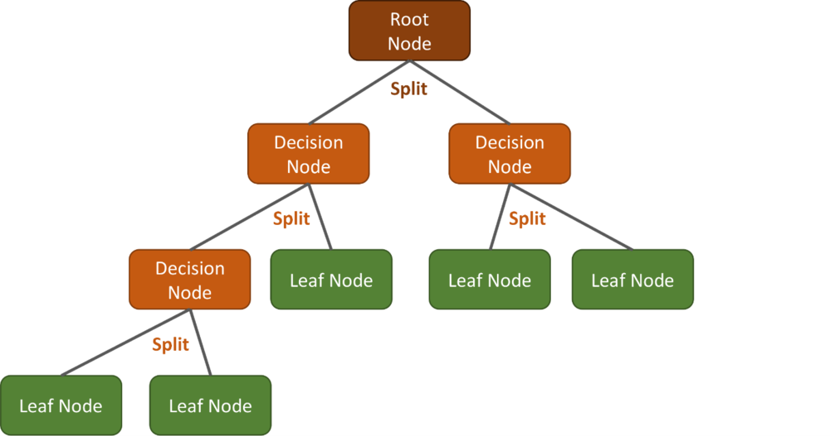
Decision Trees

Slide 7
Classification and Regression Trees (CART)
How do we organize the tree to produce the lowest classification error?
Any decision tree will successively split the data into smaller and smaller subsets.
It would be ideal if all the samples associated with a leaf node were from the same class.
Such a subset, or node, is considered pure in this case.
A generic tree-growing methodology, known as CART, successively splits nodes until they are pure.
Classification and Regression Tree

Slide 8
Classification and Regression Trees (CART)
Six key questions:
Should the questions be binary (e.g., is gender male or female) or numeric (e.g., is height >= 5’4”) or multi-valued (e.g., race)?
Which feature should be tested at each node?
When should a node be declared a leaf?
If the tree becomes too large, how can it be pruned?
If the leaf node is impure, what category should be assigned to it?
How should missing data be handled?

Slide 9
ID3 Algorithm
Iterative Dichotomiser
A ← select the “best” decision attribute to split the examples
For each value of A create new child nodes
Split training examples according to the attribute value (Sunny, Overcast, Rain)
If all training examples are perfectly classified stop, else iterate over new leaf nodes.

Slide 10


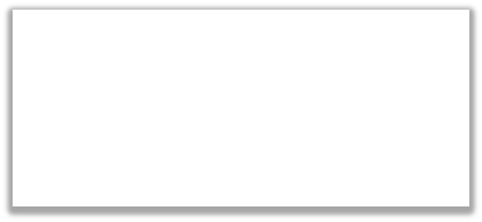
Choice 1 vs Choice 2: Comparing split on Credit vs Term
Tree | Classification error
(root) | 0.45
split on credit | 0.2
split on loan term | 0.25
Choice 1: Split on Credit
Choice 2: Split on Term
Loan status:
Safe Risky
Root
Loan status:
Safe Risky
Root
22 18
22 18
OR
Credit?
Term?
excellent
fair 8 4
poor
3 years
16 4
5 years
9 0
4 14
6 14
WINNER

Slide 11
Today’s Lecture

Slide 12
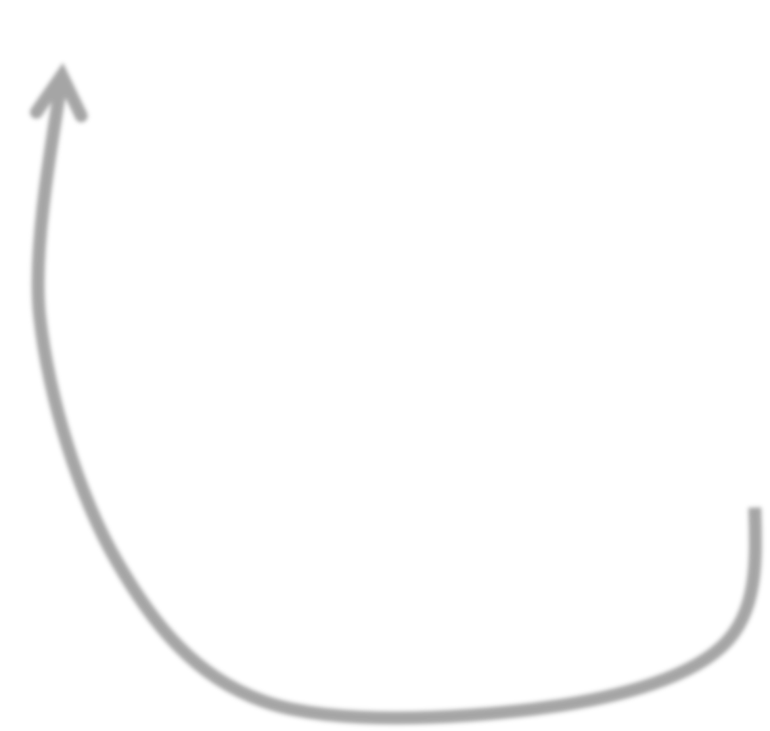
Simple greedy decision tree learning
Pick best feature to split on
Learn decision with this split
For each leaf of decision do recursion
When do we stop???
©2021 Carlos Guestrin

Slide 13
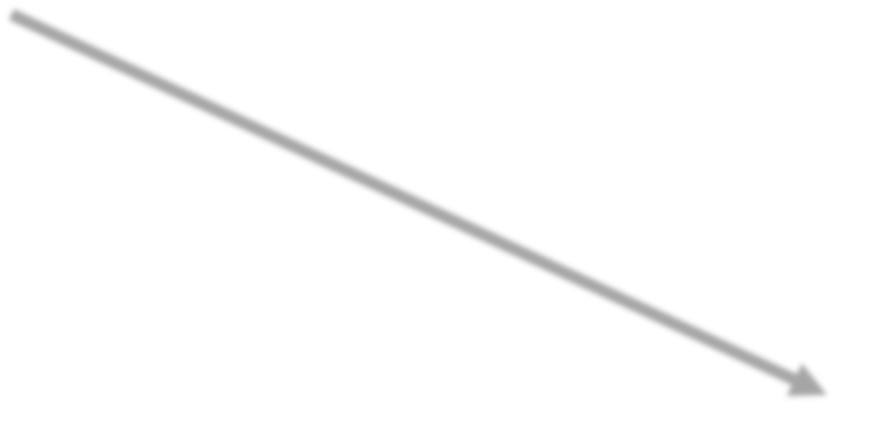
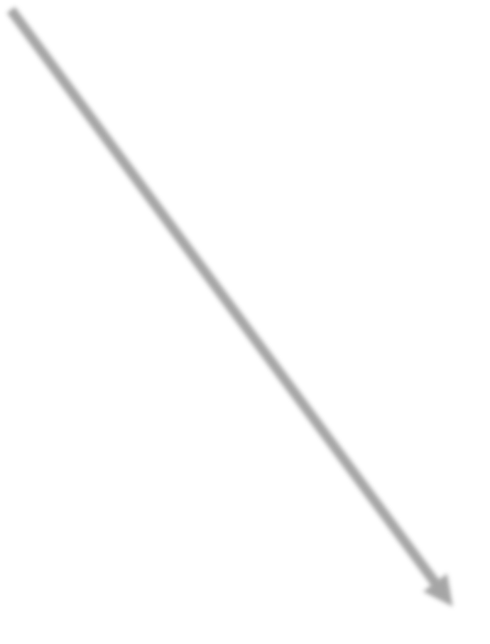

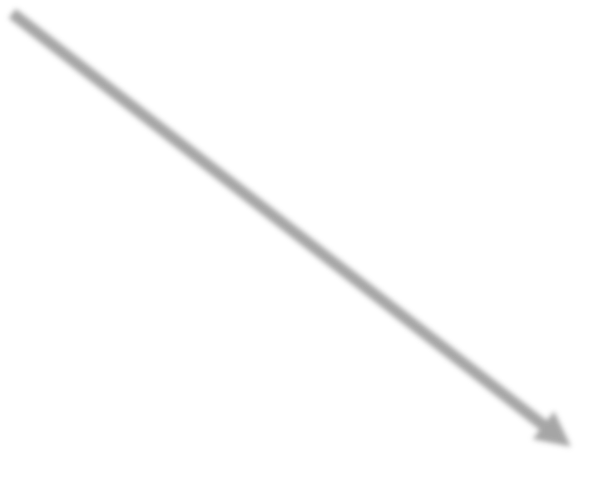
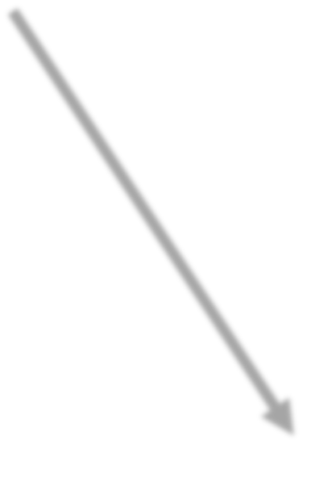
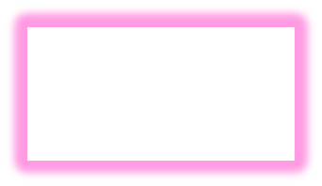
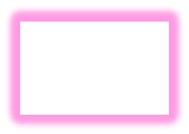
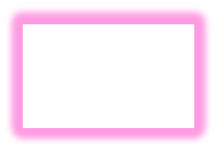
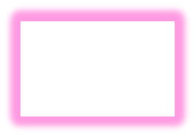
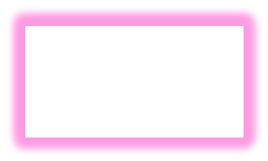
Stopping condition 1: All data agrees on y
All data in these nodes have same y value ➔ Nothing to do
Loan status:
Safe Risky
Root
22 18
poor 4 14
Credit?
Income?
excellent 9 0
excellent 9 0
Fair
high 4 5
low 0 9
9 4
low 0 9
Safe
Term?
Term?
Risky
3 years
5 years
3 years
0 4
5 years
9 0
0 4
9 0
3 years
0 2
5 years
4 3
3 years
0 2
Risky
Safe
Risky
Safe

Slide 14
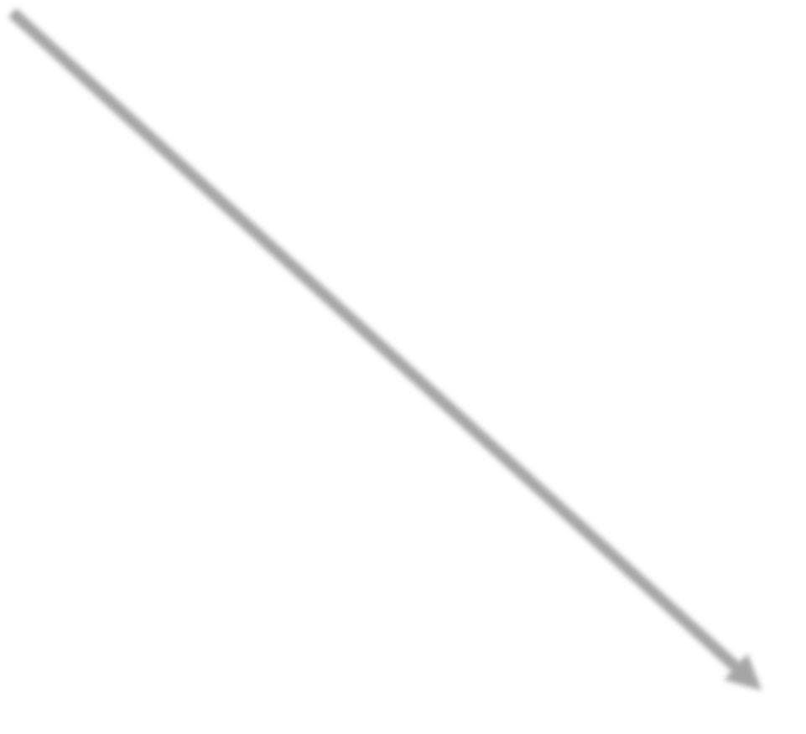
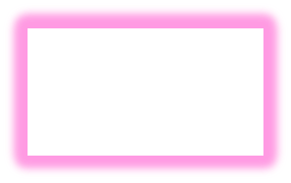
Stopping condition 2: Already split on all features
Already split on all possible features ➔ Nothing to do
Loan status:
Safe Risky
Root
22 18
poor 4 14
Credit?
Income?
excellent 9 0
Fair
9 4
high 4 5
low 0 9
Safe
Term?
Term?
Risky
3 years
5 years
0 4
9 0
3 years
0 2
5 years
4 3
5 years
4 3
Risky
Safe
Risky
Safe

Slide 15
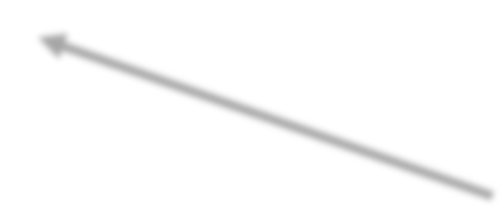
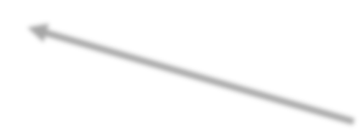
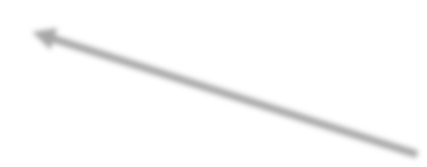
Greedy decision tree learning
Step 1: Start with an empty tree
Step 2: Select a feature to split data
For each split of the tree:
Step 3: If nothing more to do, make predictions
Step 4: Otherwise, go to Step 2 & continue (recurse) on this split
Pick feature split leading to lowest classification error
Stopping conditions 1 & 2
Recursion

Slide 16
Is this a good idea?
Proposed stopping condition 3: Stop if no split reduces the classification error

Slide 17
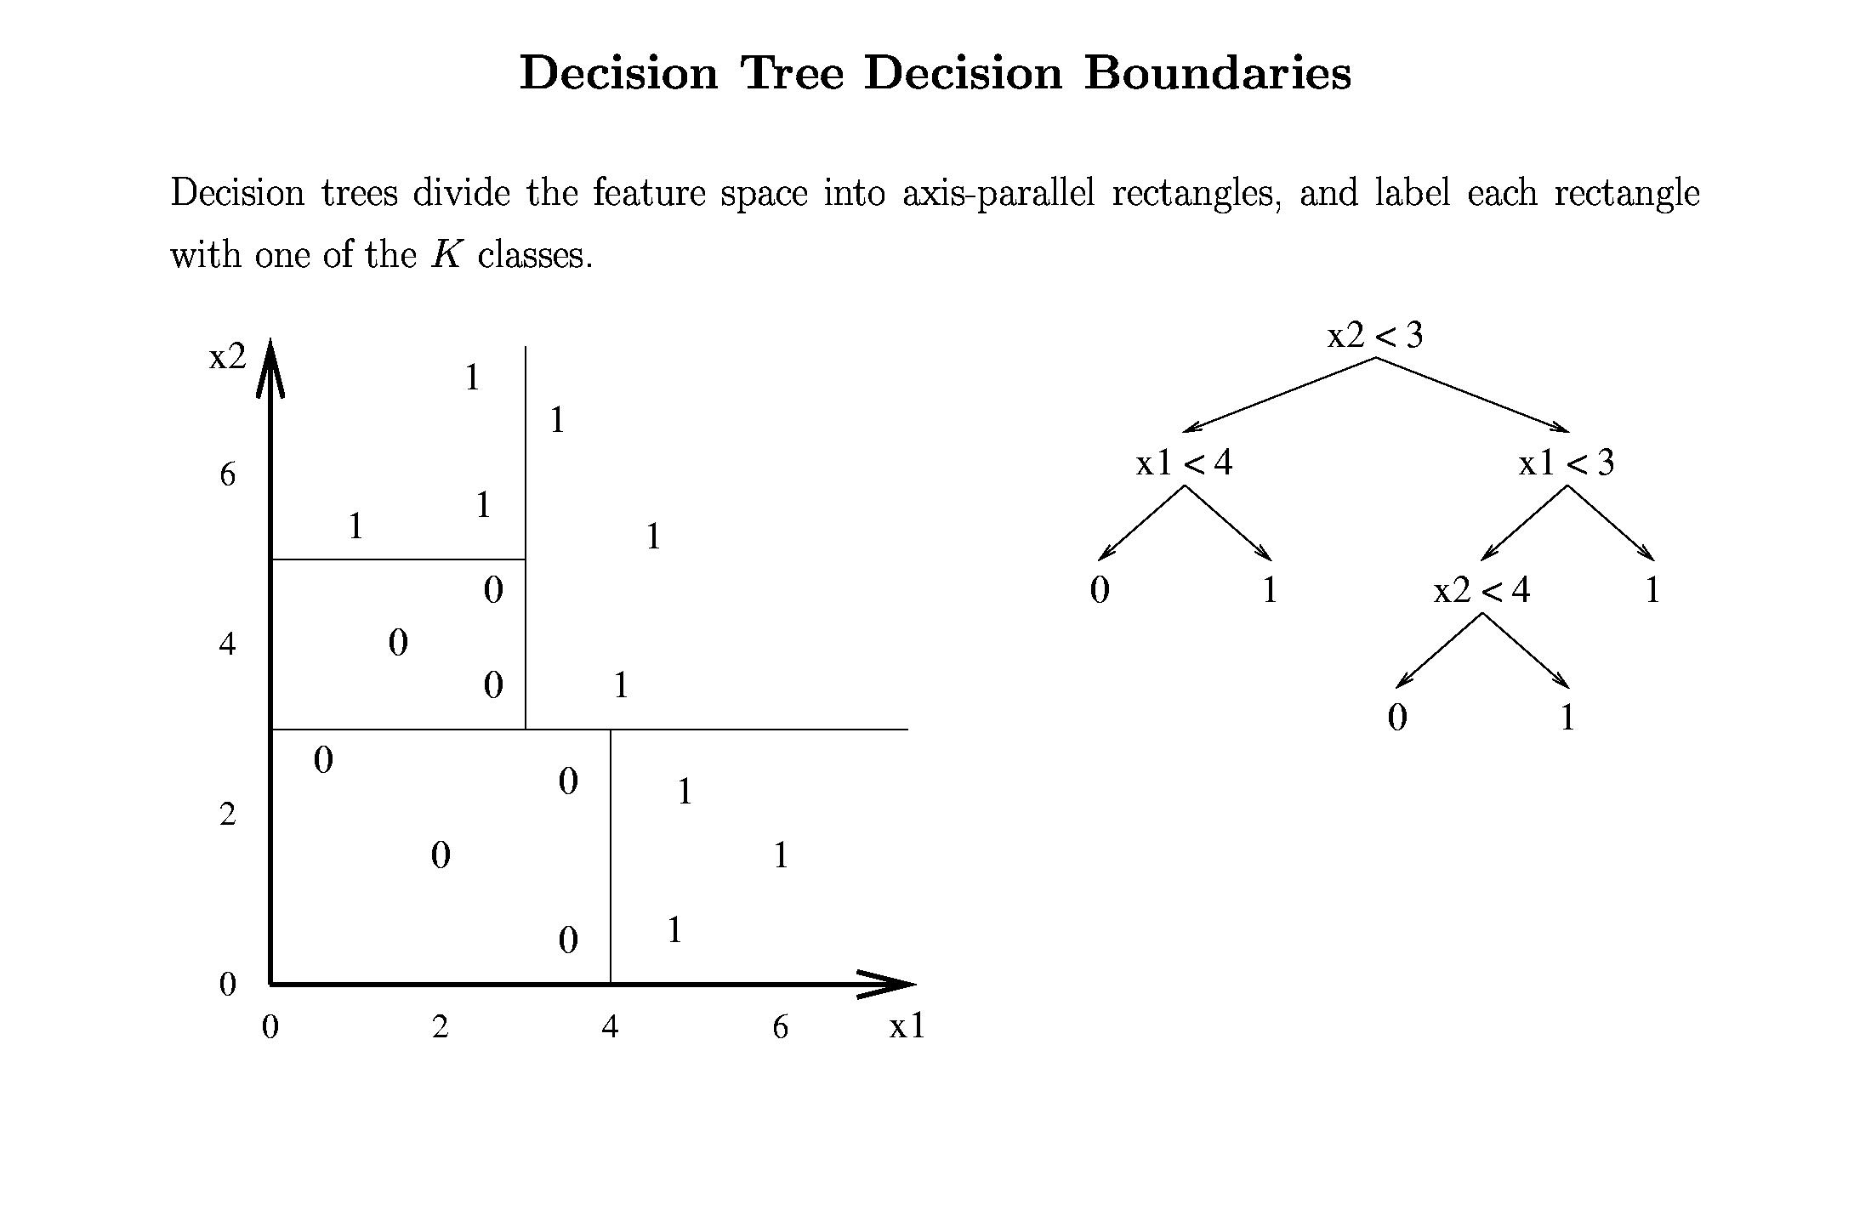

Slide 18
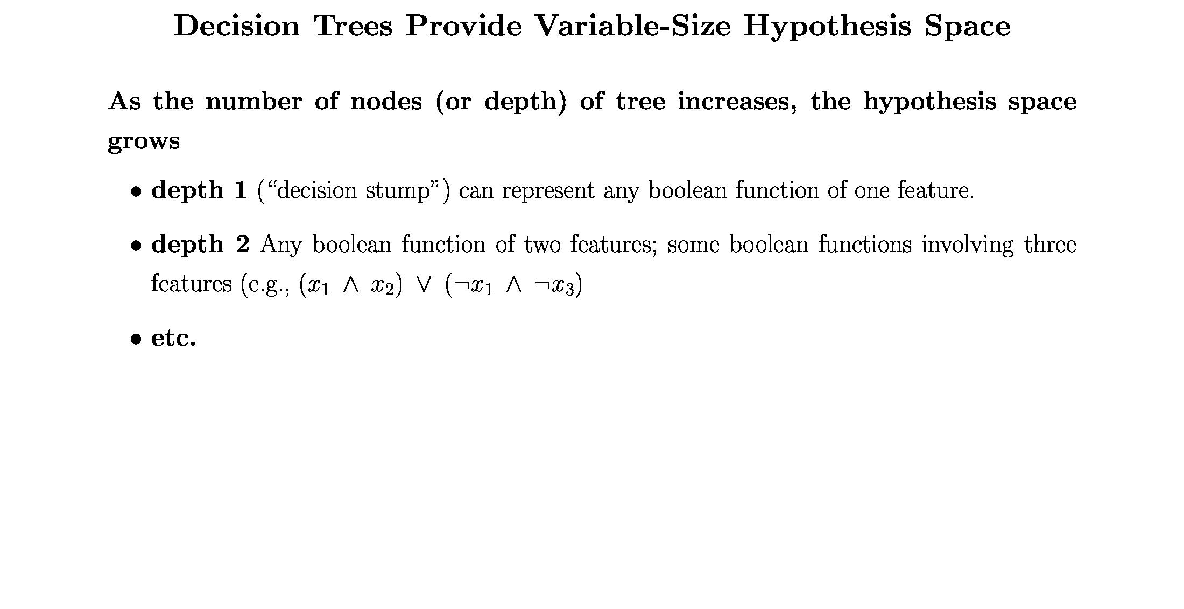

Slide 19
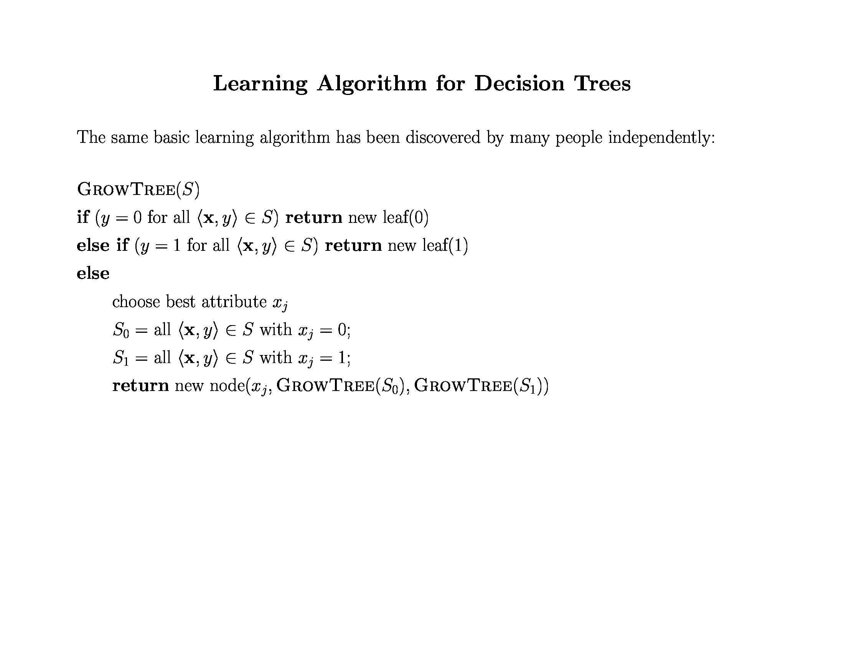

Slide 20
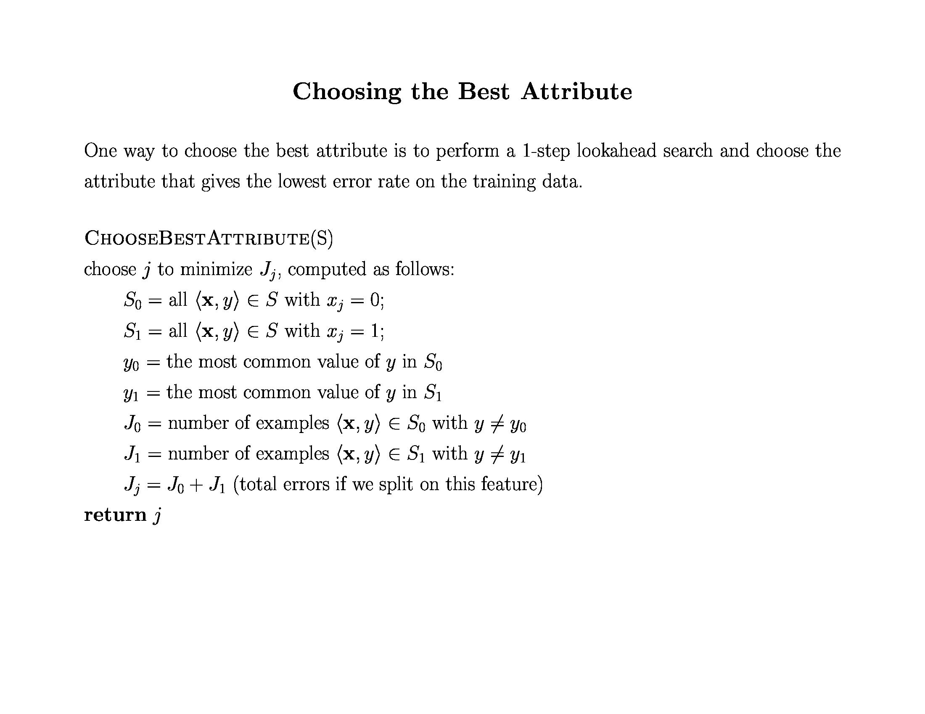

Slide 21
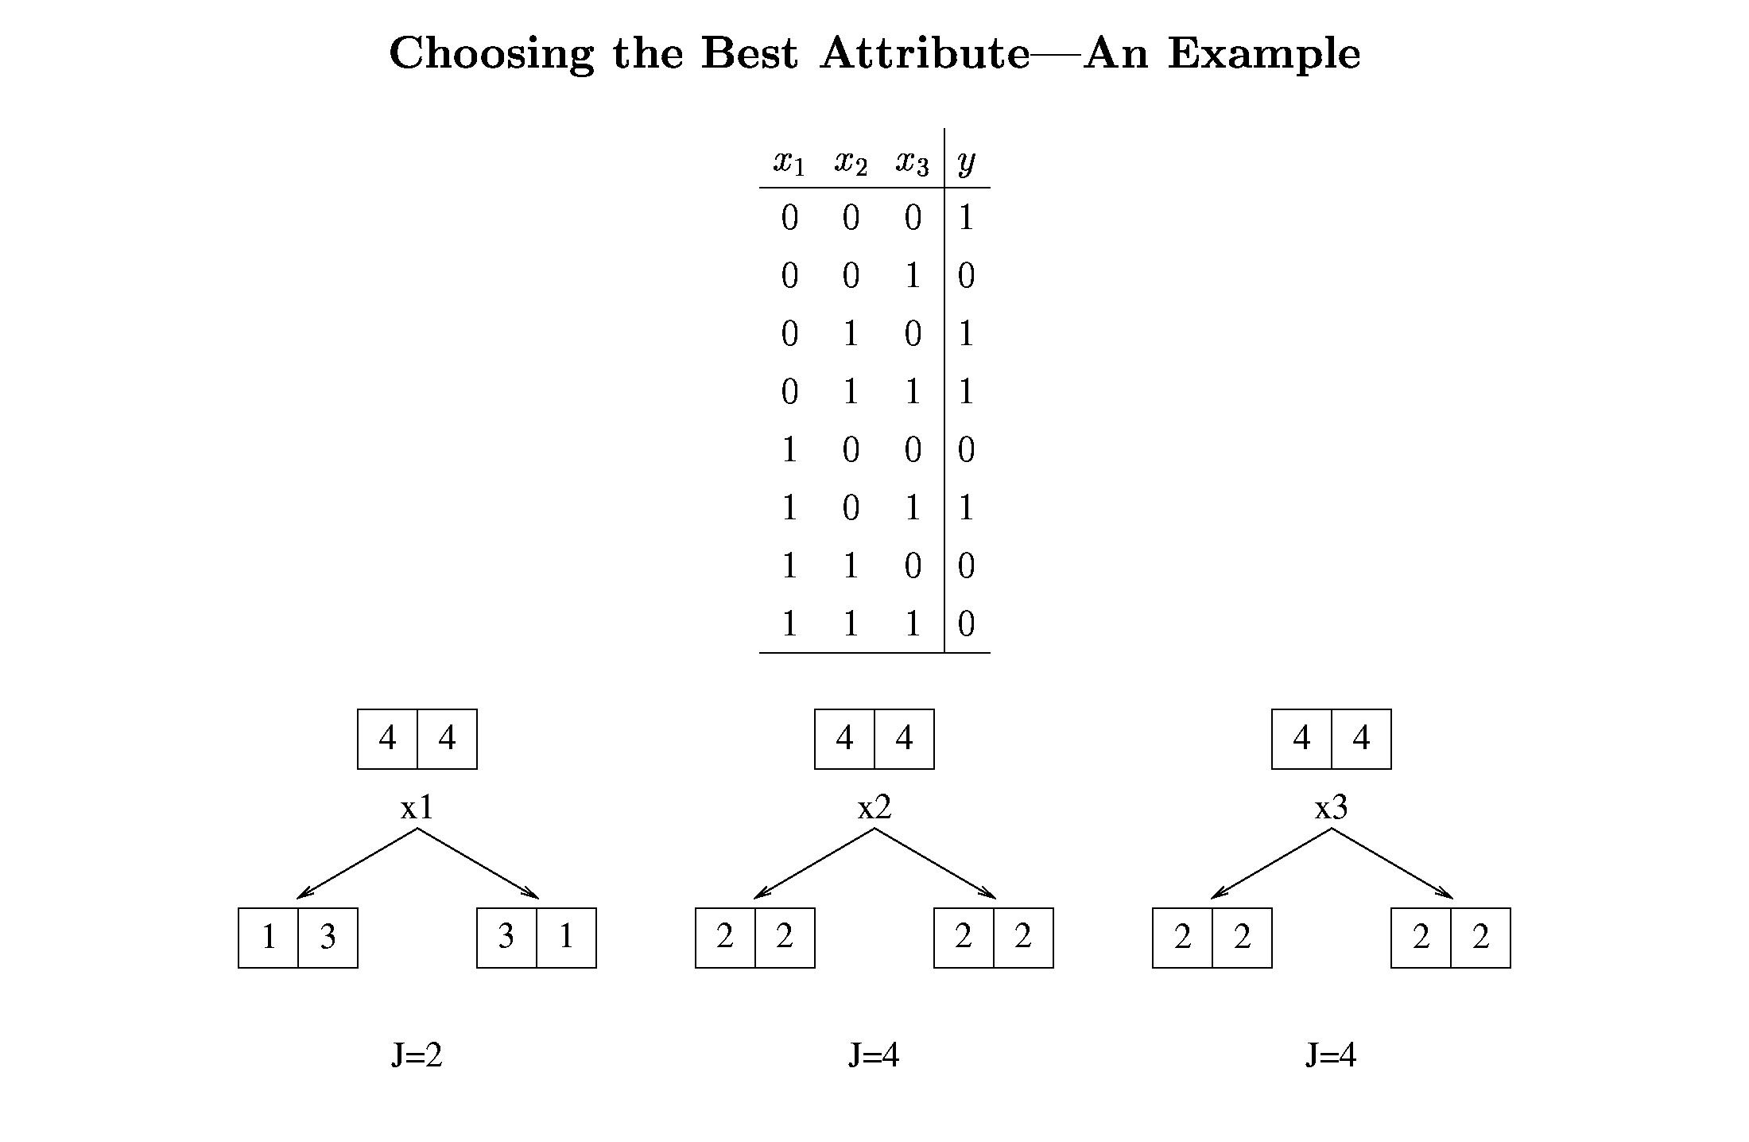

Slide 22
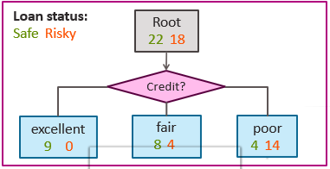
Alternate Ways
The fundamental principle for tree creation
Simple and compact tree with few nodes.
The simplest model that explains data is the one to be preferred
Find a condition T at each node N that makes the data reaching the immediate descendent nodes as “pure” as possible.
Minimum errors
What is Pure or impurity?

Slide 23
Decision Trees
Different mathematical measures of impurity
The most popular measure is the entropy impurity
Information impurity
Let i(N) be impurity of a node N.
i(N) = 0 for pure classes.
i(N) > 0 for mix classes.

Slide 24
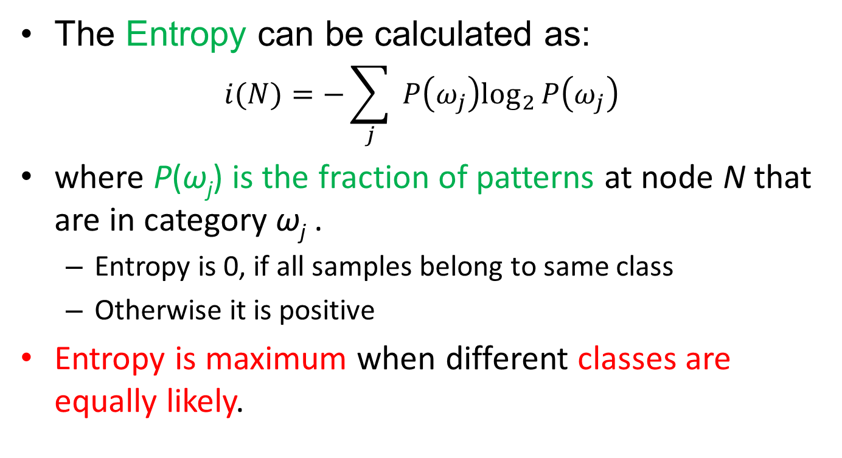
Decision Trees
The Entropy can be calculated as:
$$i(N)=−\sum_{j}{ }P\left(ω_{j}\right)\log_{2}⁡P\left(ω_{j}\right)$$
where P(ω_{j}) is the fraction of patterns at node N that are in category ω_{j} .
Entropy is 0, if all samples belong to same class
Otherwise it is positive
Entropy is maximum when different classes are equally likely.

Slide 25
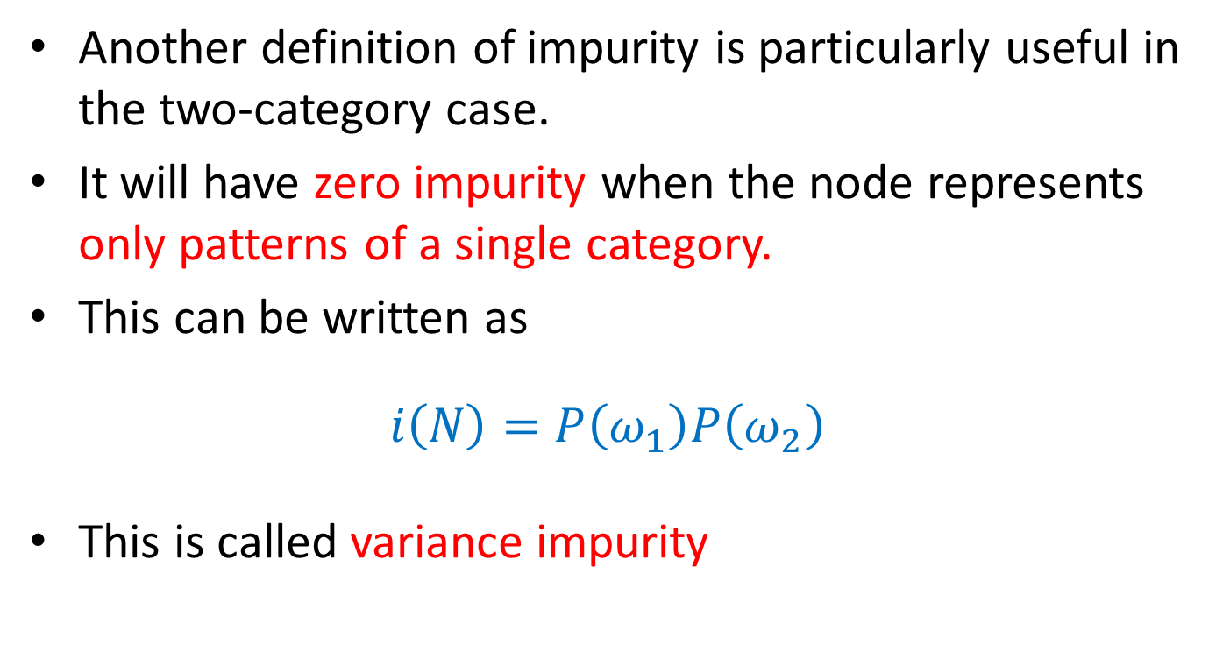
Decision Trees
Another definition of impurity is particularly useful in the two-category case.
It will have zero impurity when the node represents only patterns of a single category.
This can be written as
$$i\left(N\right)=P\left(ω_{1}\right)P\left(ω_{2}\right)$$
This is called variance impurity

Slide 26
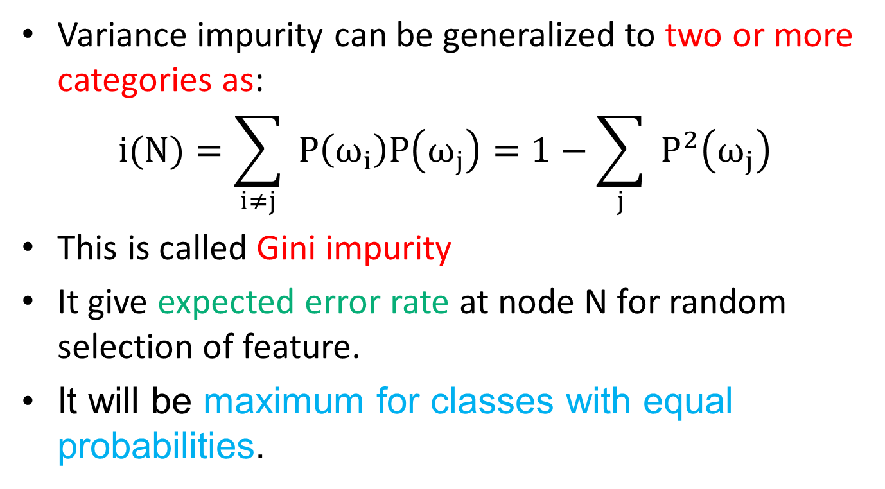
Decision Trees
Variance impurity can be generalized to two or more categories as:
$$i(N)=\sum_{i≠j}{ }P\left(ω_{i}\right)P\left(ω_{j}\right)=1−\sum_{j}{ }P^{2}\left(ω_{j}\right)$$
This is called Gini impurity
It give expected error rate at node N for random selection of feature.
It will be maximum for classes with equal probabilities.

Slide 27

Decision Trees
The misclassification impurity can be written as
$$i(N)=1−\max_{j} P\left(ω_{j}\right)$$
It measures the minimum probability that a training pattern would be misclassified at N

Slide 28
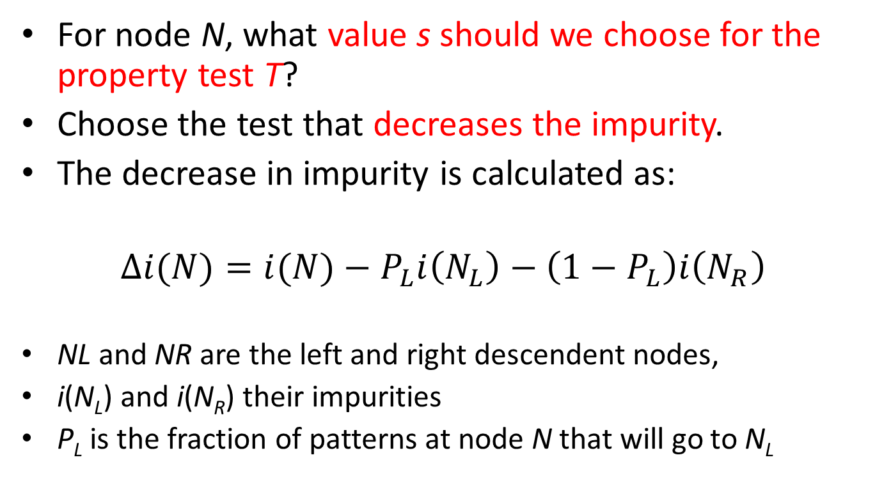
Decision Trees
For node N, what value s should we choose for the property test T?
Choose the test that decreases the impurity.
The decrease in impurity is calculated as:
$$Δi(N)=i(N)−P_{L}i\left(N_{L}\right)−\left(1−P_{L}\right)i\left(N_{R}\right)$$
NL and NR are the left and right descendent nodes,
i(N_{L}) and i(N_{R}) their impurities
P_{L} is the fraction of patterns at node N that will go to N_{L}

Slide 29
References
Chapter 3, Machine Learning, Tom Mitchell
http://cs229.stanford.edu/notes2021spring

Slide 30
Thank You ☺

